Slide 1



DEPARTMENT OF ARTIFICIAL INTELLIGENCE AND MACHINE LEARNING
SCHOOL OF COMPUTING
10214AM601 MINOR PROJECT -2
WINTER SEMESTER(2023-2024)
REVIEW-1
“FIBROINSIGHT: AI-ENABLED PULMONARY FIBROSIS PROGNOSIS”
SUPERVISED BY
PRESENTED BY
Dr. JEEVANANTHAM,ME,PhD
1.A.N.P. SRI CHARITH (VTU19917)(21UEAM0003)
2.M.V. SAI KUMAR (VTU19945)(21UEAM0040)
3.U.SRIKANTH REDDY (VTU20364)(21UEAM0067)

Slide 2
OVERVIEW
ABSTRACT
OBJECTIVE
INTRODUCTION
LITERATURE REVIEW
DESIGN AND METHODOLOGIES
IMPLEMENTATION
TESTING
INPUT AND OUTPUT
CONCLUSION
FUTURE ENHANCEMENTS
SOCIETAL IMPACT OF PROJECT
WEB REFERENCES LINK
PLAGIARISM REPORT OF PROJECT REPORT AND PPT
POSTER PRESENTATION
REFERENCES

Slide 3
ABSTRACT
This project focuses on employing machine learning techniques for predicting lung function in patients with pulmonary fibrosis.
Utilizing a dataset OSIC Pulmonary Fibrosis Progression curated for pulmonary fibrosis progression, the study aims to develop predictive models for Forced Vital Capacity (FVC) rates.
Forced Vital Capacity rate is a variable for determination of lung health. It also helps in determination of the oxygen present in lungs.
Various machine learning algorithms are explored and evaluated for their effectiveness in accurately predicting FVC values.
Especially we aim to various classification and regression algorithms like SVM- support vector machine , LASSO – least absolute shrinkage and selection.
Feature engineering methods are employed to extract relevant information from medical imaging data and clinical metadata.
The research contributes to the advancement of medical diagnostics by offering computational tools for early detection and monitoring of pulmonary fibrosis progression.

Slide 4
OBJECTIVES
1.Aim of the project
The primary objective of this project is to employ machine learning techniques to develop predictive models capable of estimating lung function, with a specific focus on predicting Forced Vital Capacity (FVC) rates, among individuals diagnosed with pulmonary fibrosis.
These models aim to leverage advanced computational methods to provide accurate predictions of lung function progression in patients with pulmonary fibrosis, thereby aiding in disease management and treatment planning.
By utilizing machine learning algorithms and appropriate feature engineering techniques, this research endeavors to contribute to the advancement of medical diagnostics and enhance our understanding of pulmonary fibrosis progression.
Ultimately, the goal is to develop reliable computational tools that healthcare professionals can utilize for early detection, monitoring, and personalized management of pulmonary fibrosis.

Slide 5
OBJECTIVES
2.Scope of the project
Data Collection and Preprocessing: Gathering and preprocessing a comprehensive dataset consisting of imaging data (DICOM format) and relevant clinical metadata from individuals diagnosed with pulmonary fibrosis.
Feature Engineering: Employing advanced feature engineering techniques to extract meaningful features from the imaging data and metadata to facilitate accurate prediction of lung function.
Model Development: Exploring various machine learning algorithms, including but not limited to regression and ensemble methods, to develop predictive models for estimating Forced Vital Capacity (FVC) rates.
Evaluation and Validation: Assessing the performance of developed models through rigorous evaluation metrics and cross-validation techniques to ensure their robustness and reliability.
Interpretability and Clinical Application: Interpreting model outcomes and insights to provide clinically relevant information that can assist healthcare professionals in disease management and treatment decision-making for individuals with pulmonary fibrosis.

Slide 6
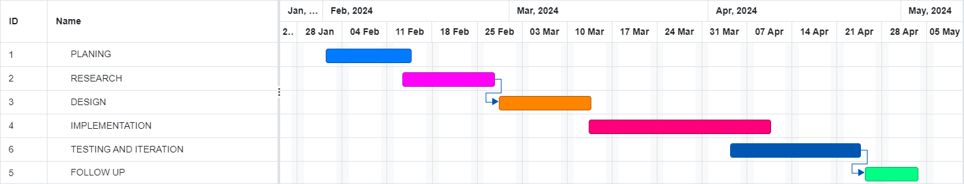
TIMELINE OF THE PROJECT
Gantt chart

Slide 7
INTRODUCTION
Pulmonary fibrosis represents a progressive lung pathology characterized by the gradual scarring of lung tissue, necessitating precise measurement of Forced Vital Capacity (FVC) rates crucial for diagnosis and therapeutic intervention.
Conventional assessment methodologies often lack the precision required to discern subtle changes in pulmonary fibrosis progression, prompting the exploration of more advanced diagnostic approaches.
This project seeks to harness the power of machine learning techniques and medical imaging data, specifically DICOM images and accompanying clinical metadata, to develop predictive models capable of estimating FVC rates in individuals afflicted with pulmonary fibrosis.
By employing sophisticated feature engineering methods and a diverse array of machine learning algorithms, including regression and ensemble techniques, the aim is to refine the accuracy and robustness of these predictive models.
The anticipated outcomes of this research endeavor hold significant promise in advancing clinical decision-making processes, facilitating early disease detection, and tailoring personalized management strategies for patients grappling with pulmonary fibrosis, thereby fostering improved patient outcomes and overall quality of life

Slide 8
LITERATURE REVIEW
Author’s Name | Paper name and publication details | Year of publication | Main content of the paper
Sampurna Mandal; Valentina E. Balas; Rabindra Nath Shaw; Ankush Ghosh | Prediction Analysis of Idiopathic Pulmonary Fibrosis Progression from OSIC Dataset | 2020 IEEE International Conference on Computing, Power and Communication Technologies (GUCON) | This paper aims to analyze and compare the performance of various machine learning models in predicting forced volume capacity measurements and confidence values from CT scan data, facilitating early diagnosis and efficient resource allocation in managing pulmonary fibrosis.
R Keerthana; Sindu Divakaran; S Nisha | A robust deep learning method for radiation induced pulmonary fibrosis disease classification in lung CT-a review | 2022 International Conference on Power, Energy, Control and Transmission Systems (ICPECTS) | Developing a deep learning model, I-CRAWL, to accurately segment pulmonary fibrosis (PF) lesions from CT scans, overcoming challenges like varied lesion characteristics and limited annotated data. The model integrates semi-supervised learning, image pre-processing, segmentation, feature extraction, and classification steps, aiming to facilitate precise diagnosis and treatment monitoring of PF using CT imaging.

Slide 9
LITERATURE REVIEW
Author’s Name | Paper name and publication details | Year of publication | Main content of the paper
Upasana Chutia; Anand Shanker Tewari; Jyoti Prakash Singh | Analysis of Idiopathic Pulmonary Fibrosis through Machine Learning Techniques | 2021 8th International Conference on Smart Computing and Communications (ICSCC) | This aim to predict lung function decline in Idiopathic Pulmonary Fibrosis (IPF) patients, aiding in medication optimization and prolonging patient longevity. Early detection is crucial to mitigate morbidity, mortality, and healthcare costs.
Angeliki Poulou; Marios Poulos; Maximilianos Panas | A regression-based machine learning approach for the prediction of lung function decline | 2022 12th International Conference on Dependable Systems, Services and Technologies (DESSERT) | Pulmonary fibrosis is a progressive lung disease where early detection is critical. In the Kaggle competition "OSIC Pulmonary Fibrosis Progression Predict lung function decline," our approach achieved a Laplace Log Likelihood score of -6.8590, earning a bronze medal. Using CT scans and clinical data, including spirometry FVC measurements, from 176 patients, we developed a simple yet accurate model to predict lung function decline by estimating FVC and a confidence measure through a sigmoid equation derived from a novel transformation of three parameters.

Slide 10
DESIGN AND METHODOLOGIES
MODULE 1: EXPLORTORY DATA ANAYSIS
This helps in data analysis like univariate , bi-variate and multi variate using various graphs.
MODULE 2: META DATA AND DICOM DATA ANALYSIS
This includes processing data cleaning it and making it ready to implement algorithms.
MODULE 3: MODEL SELECTION
Selecting and trying various machine learning models to find which one is best.
MODULE 4: TRAINIG AND TESTING
Training and Testing the model to find the accurate and mot helpful model.
MODULE 5: EVALUATION
Evaluating model based on laplace log likelihood metric using forced vital capacity.

Slide 11
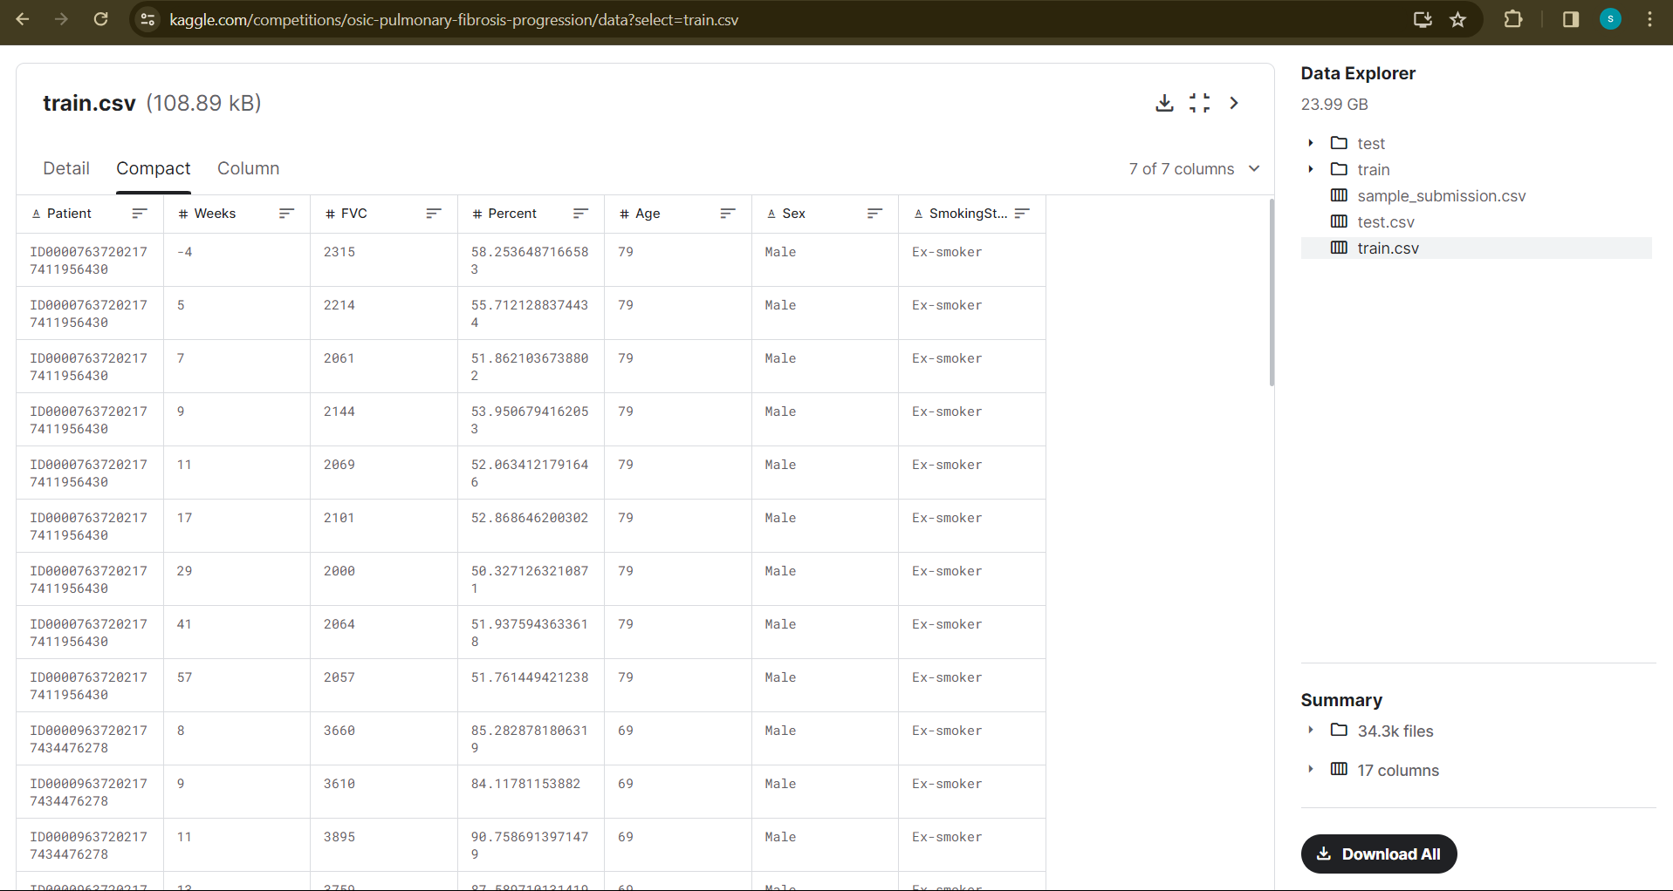
MODULE 1: EXPLORATORY DATA ANALYSIS
Step 1: collecting data
For predicting lung function we are using OSIC Pulmonary Fibrosis Progression dataset.
This has train and test data with dicom data for image analysis.

Slide 12
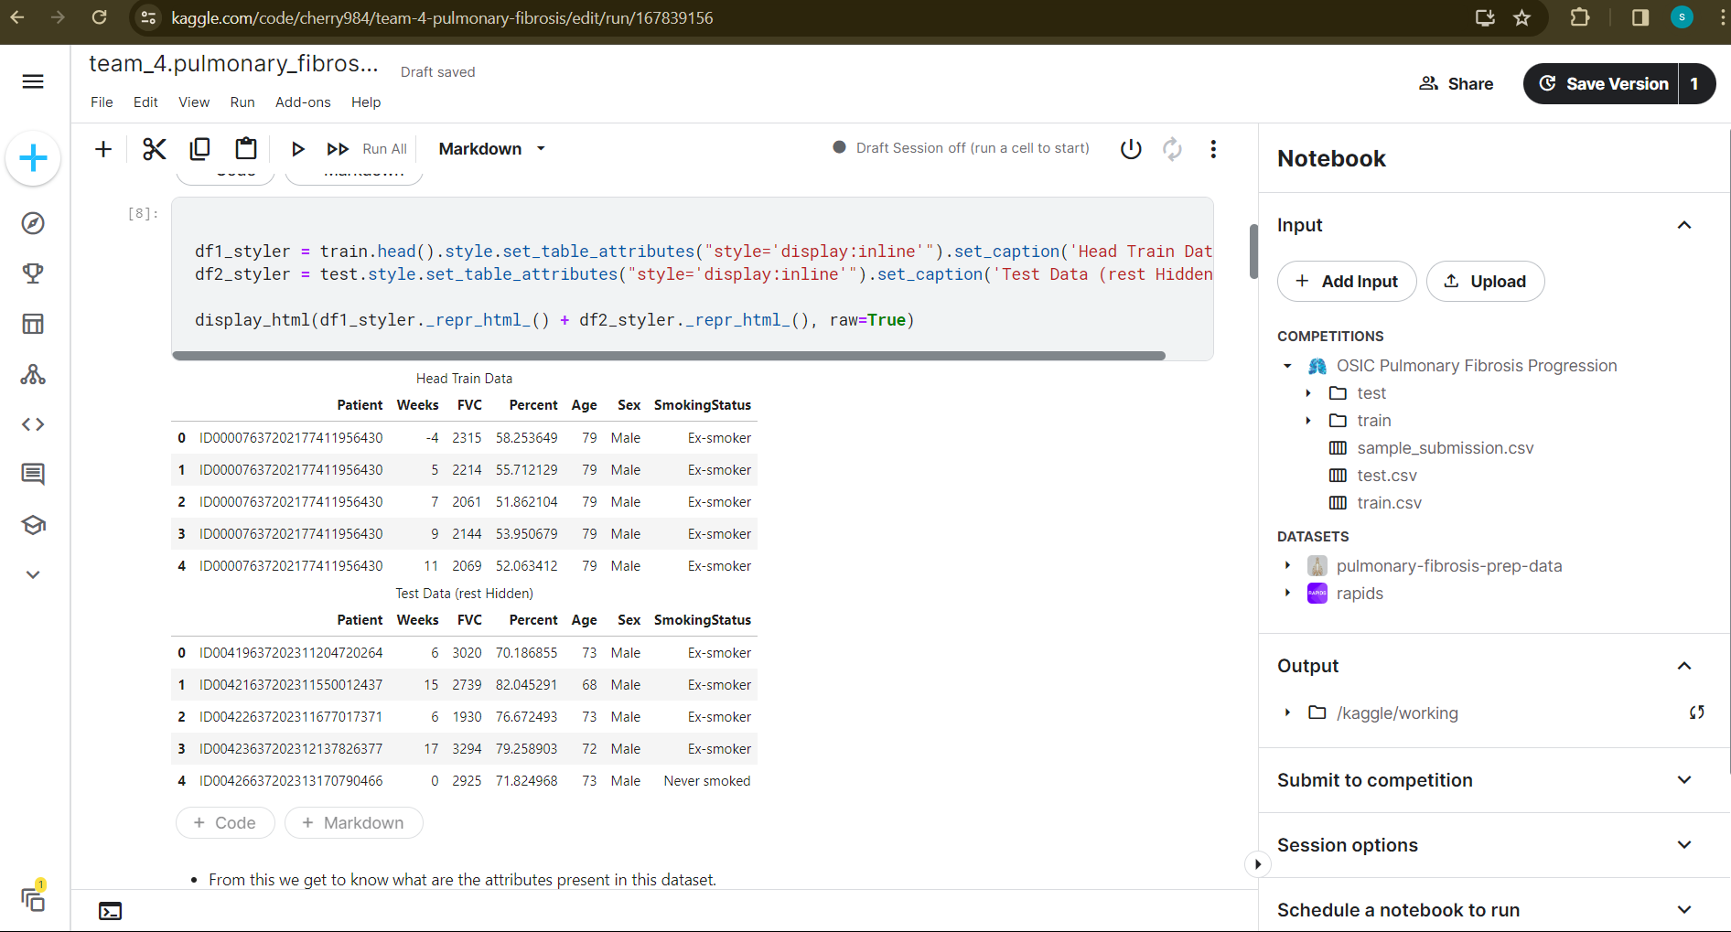
Step 2: Processing the data
the collected data will be processed by cleaning data and removing null values.
Since it is an large dataset this is done by using various python libraries like pandas, numpy.

Slide 13
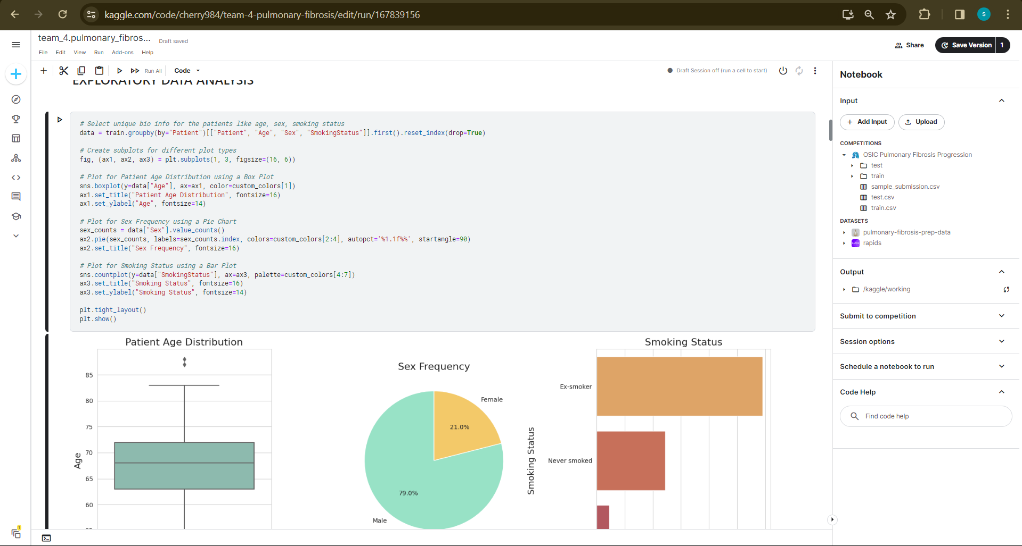
MODULE 2: META DATA AND DICOM DATA ANALYSIS
Meta data is data is a data that provides content about other data.
Here we use metadata analysis to visualize and understand the dataset and its variables.

Slide 14
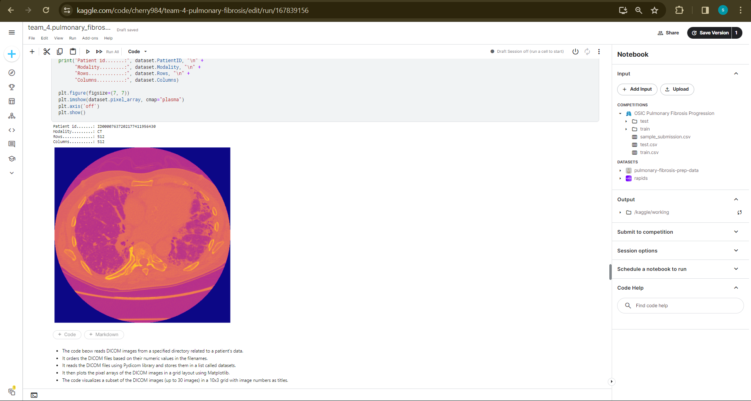
Dicom data is image data stored in dicom file format. This is also used to visualize the images of lungs in gif or apply various masks in lungs.

Slide 15
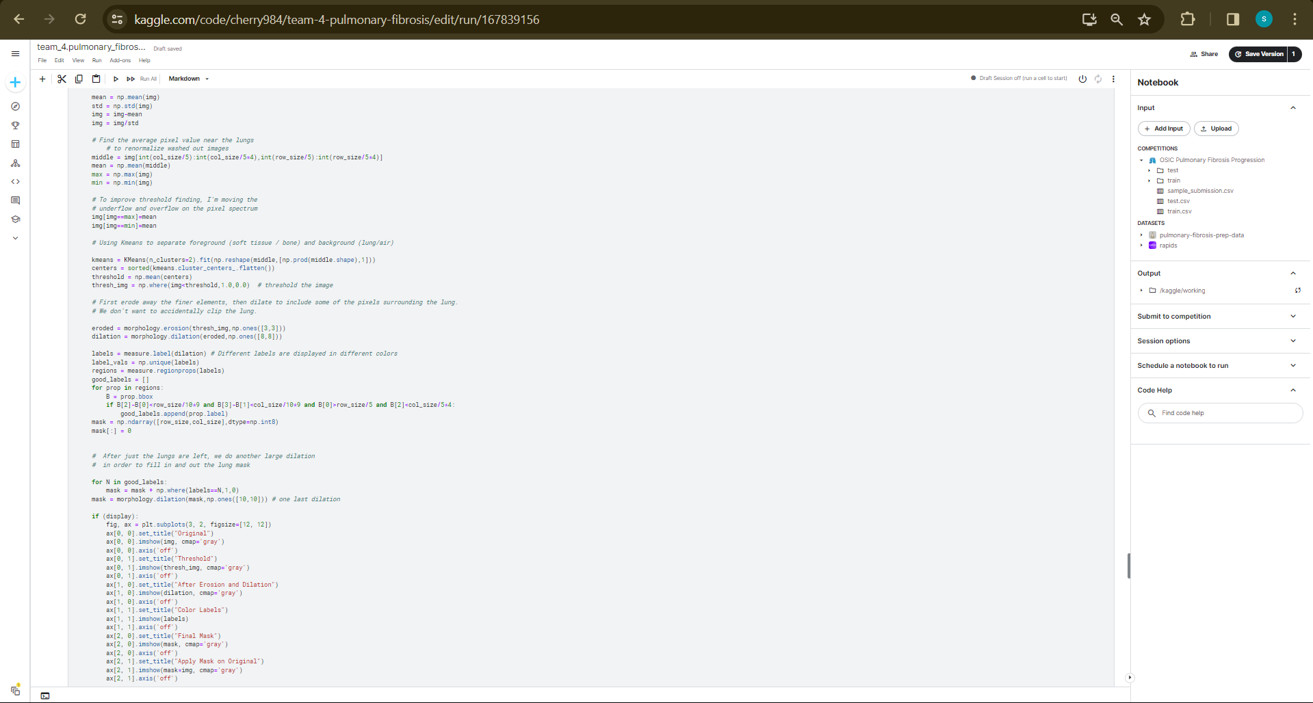
Step 3: Using various masks to identify lung distortion

Slide 16
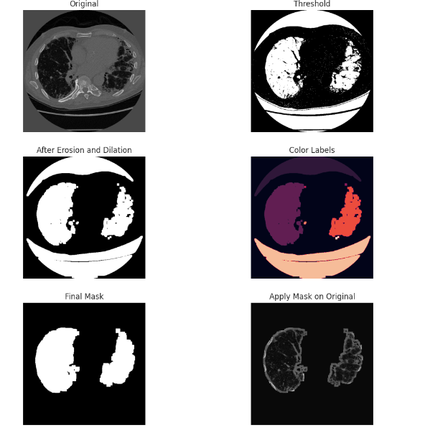
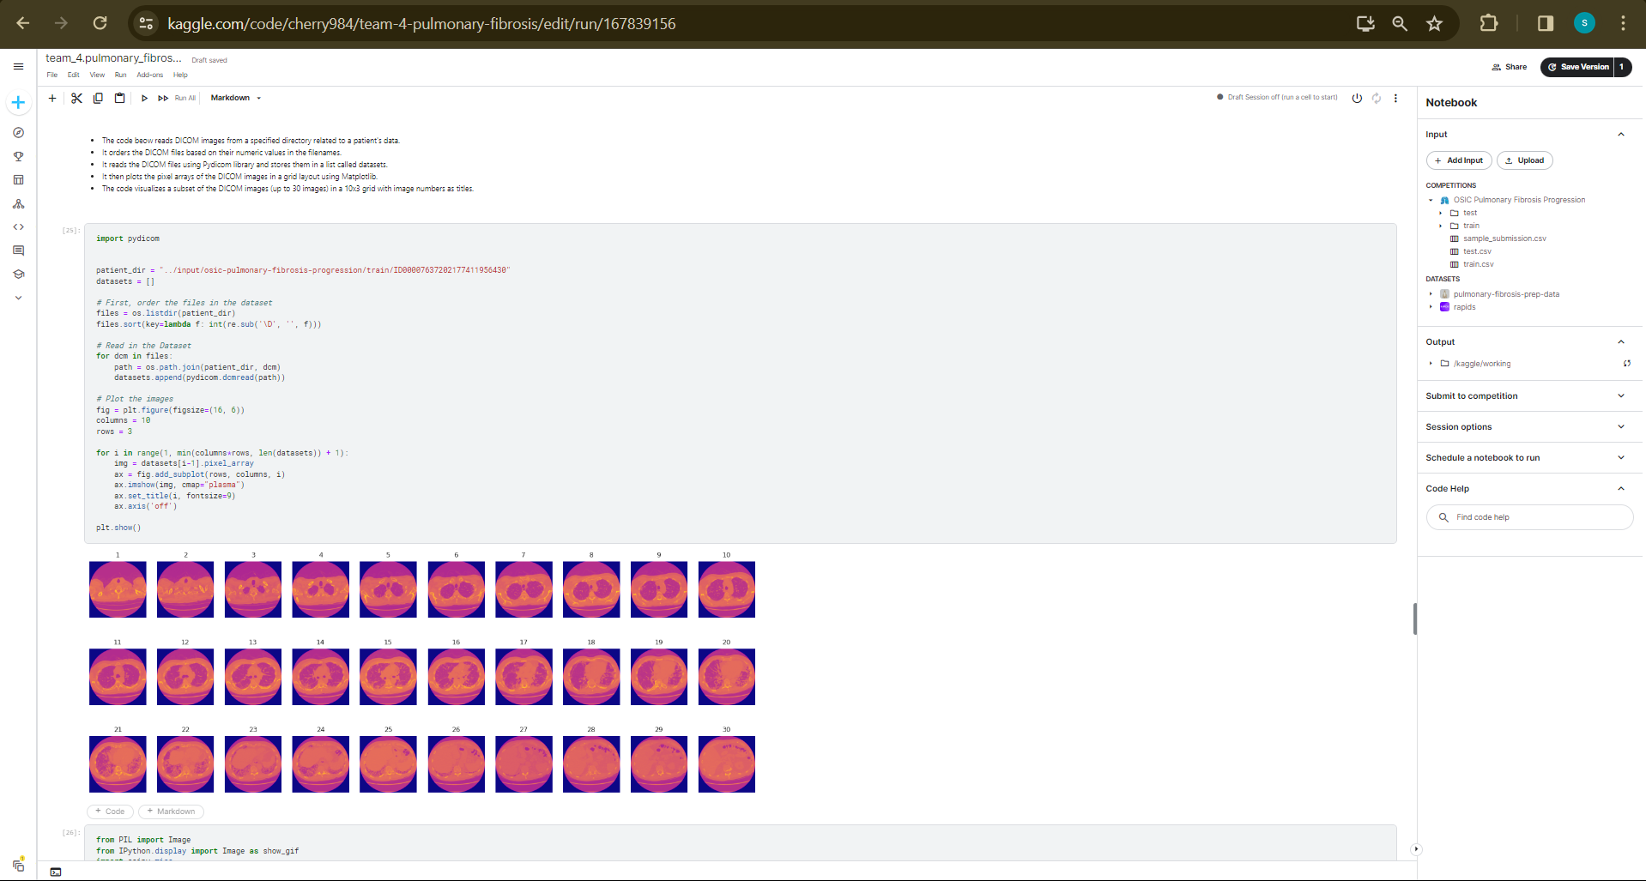
Step 4: The output

Slide 17
IMPLEMENTATION
Architecture Diagram
Data –Flow Diagram
Class Diagram
Activity Diagram
Sequence Diagram
Collaboration Diagram(If applicable)
E-R Diagram

Slide 18
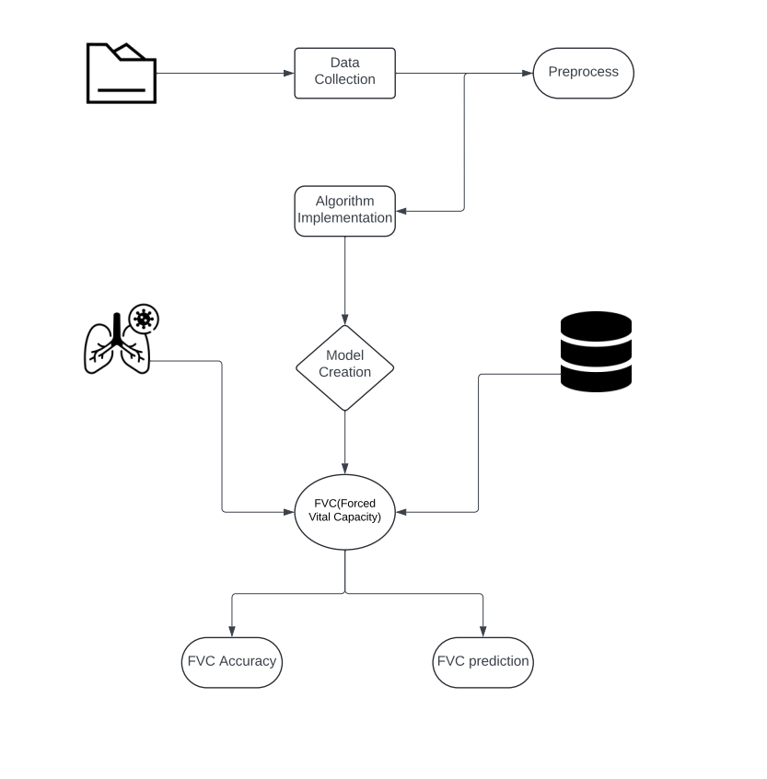
Architecture Diagram
Data Input:
The system receives patient data, including chest X-ray images and medical history information, represented by the "Patient Data" class.
Preprocessing:
The received data undergoes preprocessing tasks such as image resizing, format conversion, and noise reduction, handled by the "Preprocessing Module" class.
Feature Extraction:
After preprocessing, relevant features are extracted from the data, which could include image intensity values or textures, performed by the "Feature Extraction Module" class.
Machine Learning Model:
The extracted features are then fed into the "Machine Learning Model" class, which represents a trained model capable of predicting the presence of pulmonary fibrosis based on the input features.
Prediction Output:
Finally, the system generates a prediction output, represented by the "Prediction" class, indicating whether the input chest X-ray image shows signs of pulmonary fibrosis or not.

Slide 19
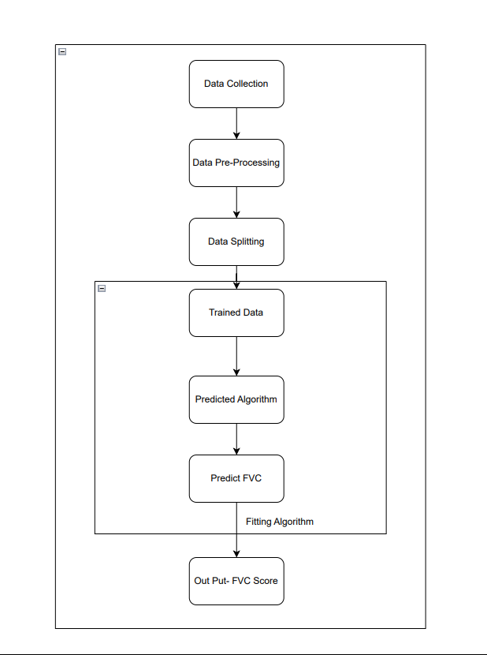
Data –Flow Diagram
The above diagram represents the flow of data which starts from dataset osis pulmonary fibrosis and then initiated into various parts of code. It is shown that this dataset has three sub files named train , test and sample data.

Slide 20
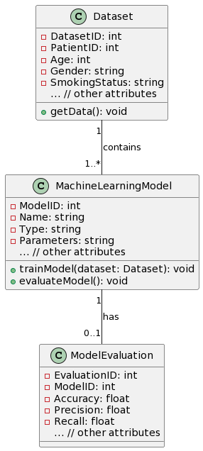
Class Diagram

Slide 21
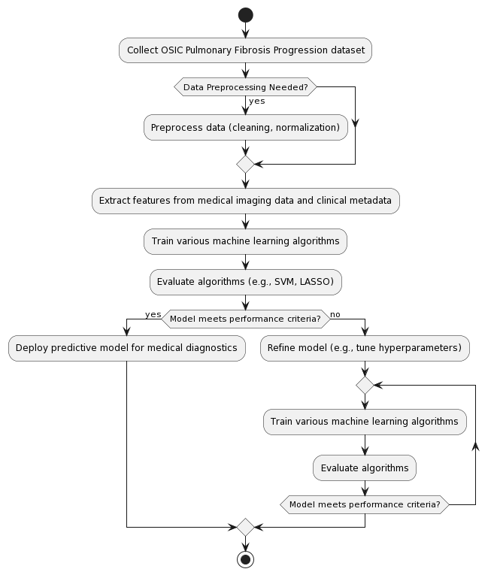
Activity Diagram

Slide 22
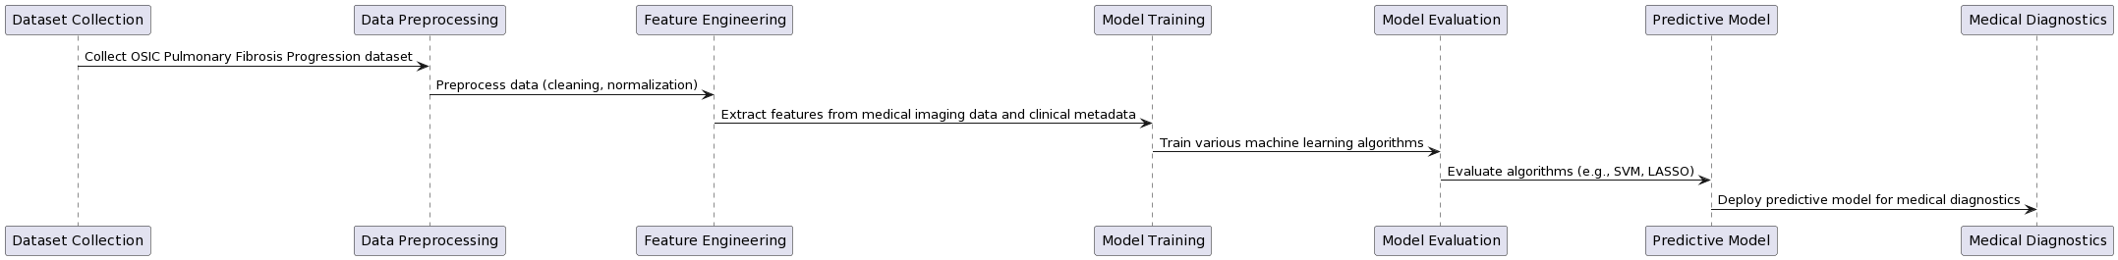
Sequence Diagram

Slide 23
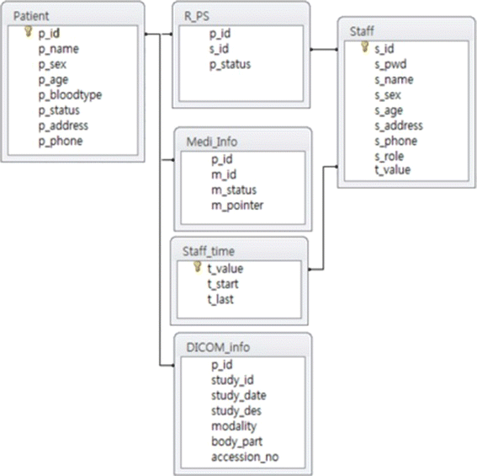
E-R Diagram

Slide 24
TESTING
UNIT TESTING
FUNCTIONAL TESTING

Slide 25
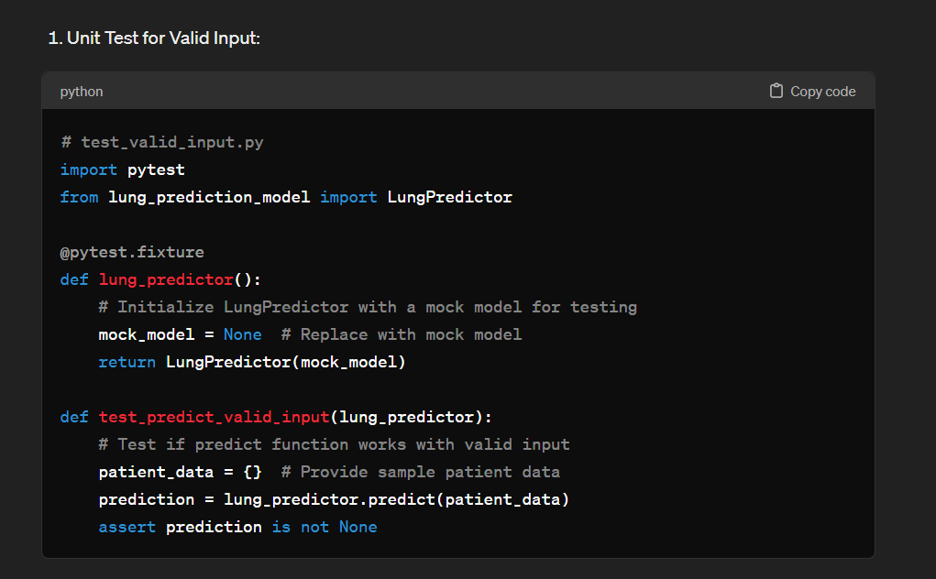
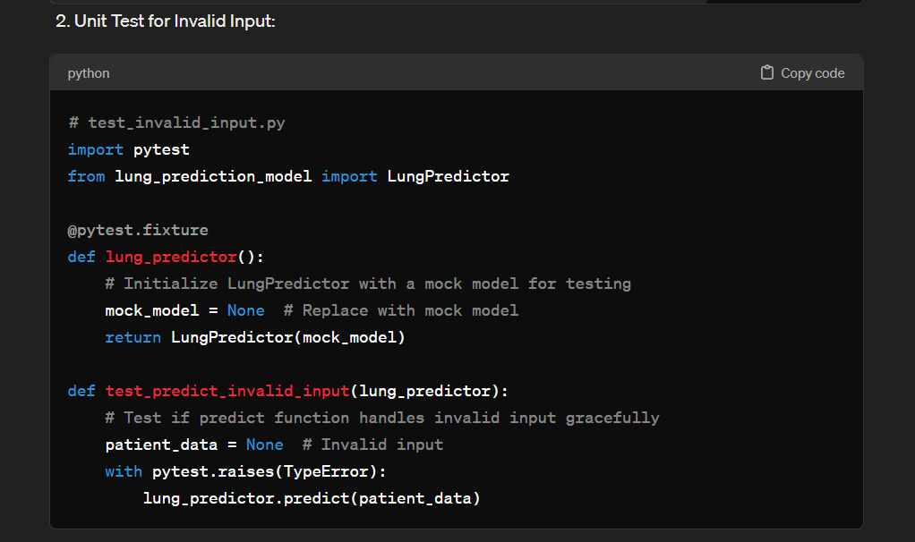
UNIT TESTING
Unit testing involves testing individual components of the software program or application. The main purpose behind this is to check that all the individual parts are working as intended. A unit is known as the smallest possible component of software that can be tested.
System testing and integration testing are not applicable for this project as it is a predictive model and has no external integration software.

Slide 26
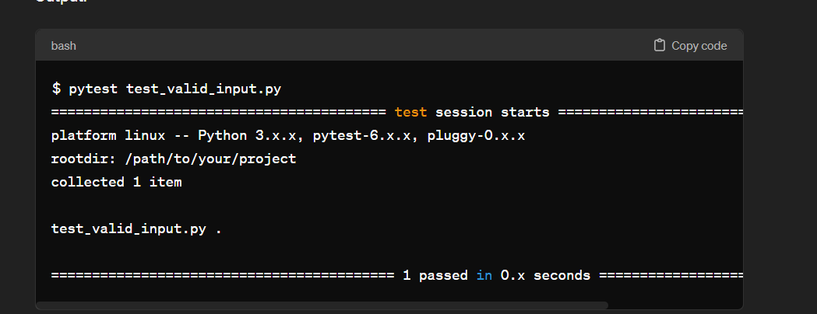
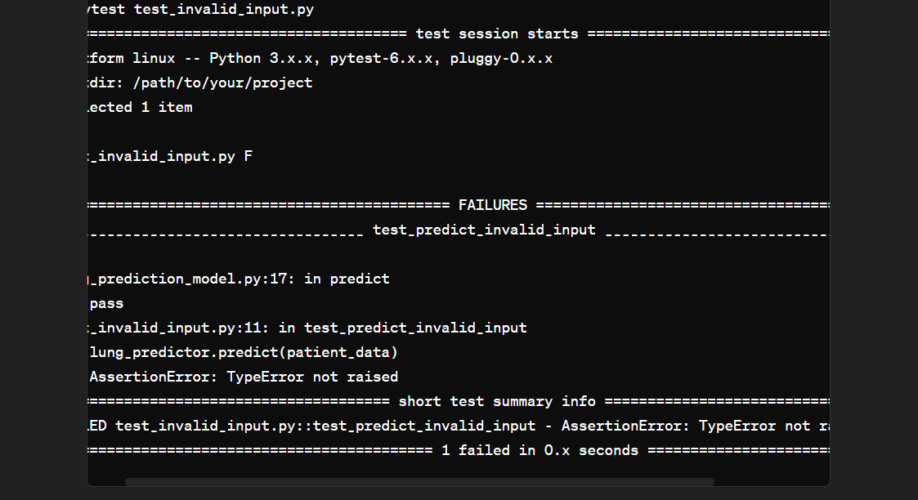
UNIT TESTING OUTPUT
This shows two unit tests with one valid input and other invalid input. Valid input file the test passed and returned model and when invalid input the test return an exception.

Slide 27
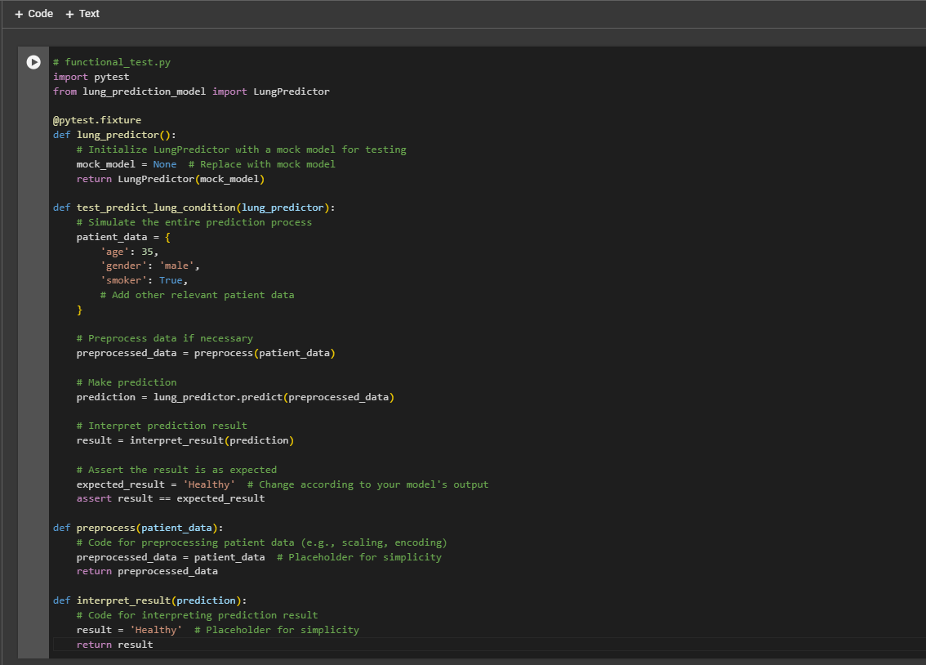
FUNCTIONAL TESTING

Slide 28
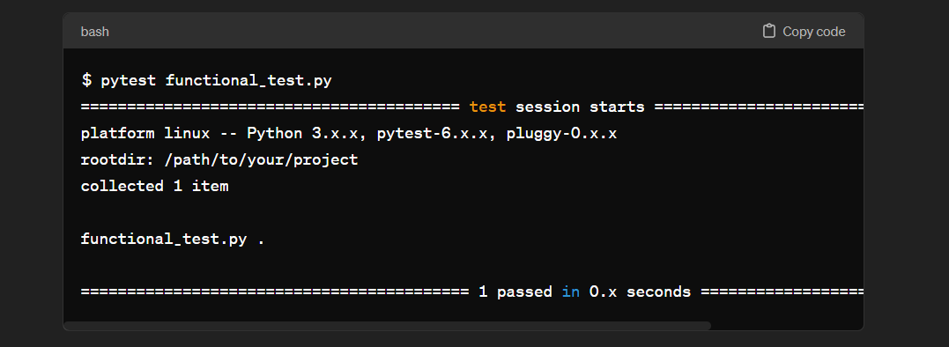
FUNCTIONAL TESTING OUTPUT

Slide 29
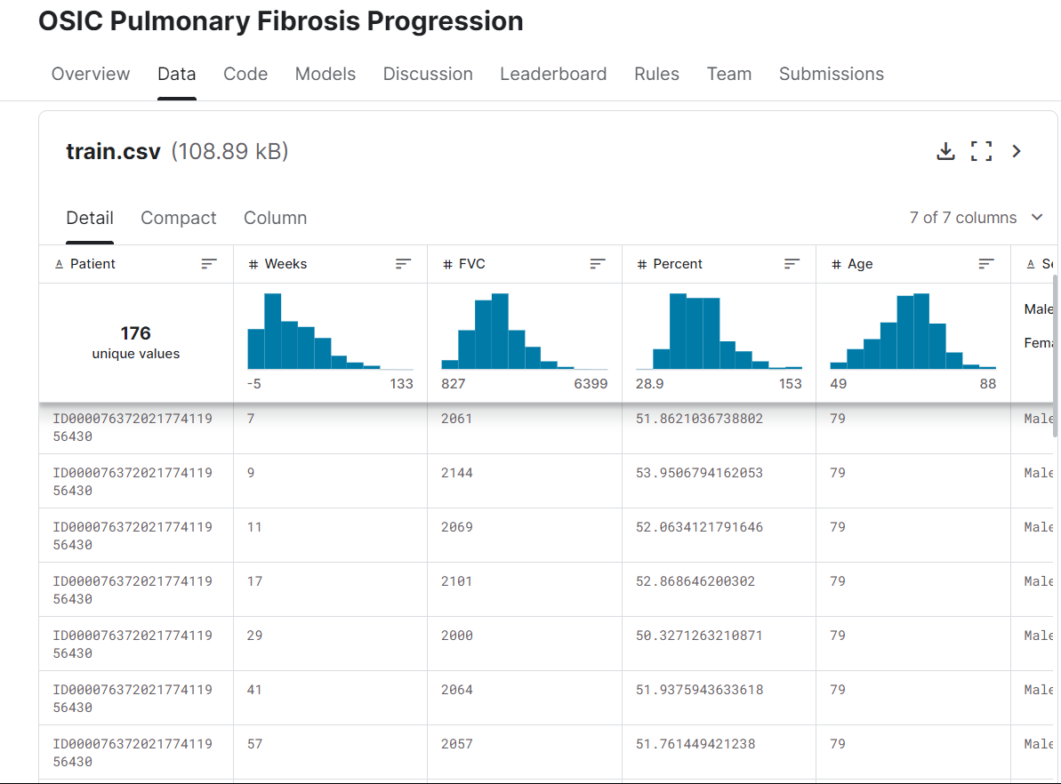
INPUT AND OUTPUT

Slide 30
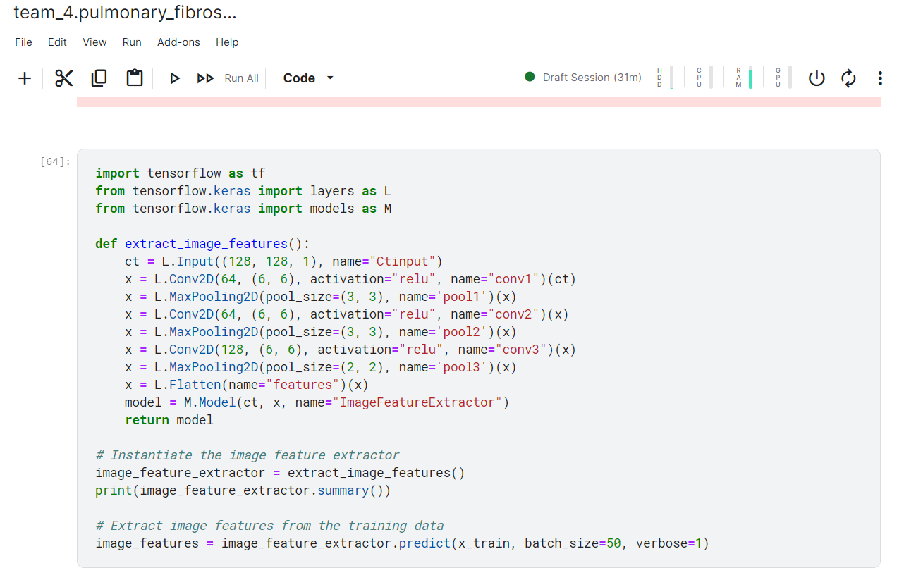
SOURCE CODE

Slide 31
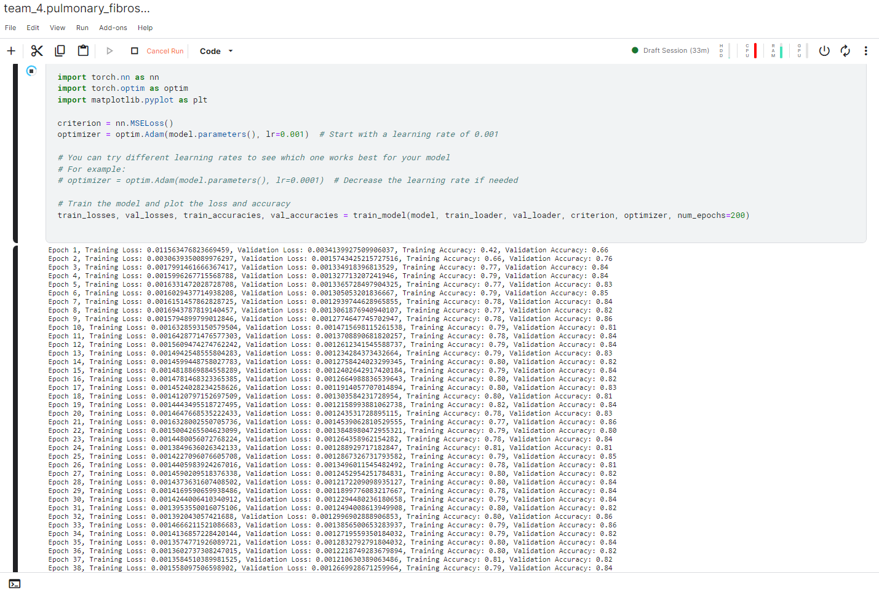
SOURCE CODE

Slide 32
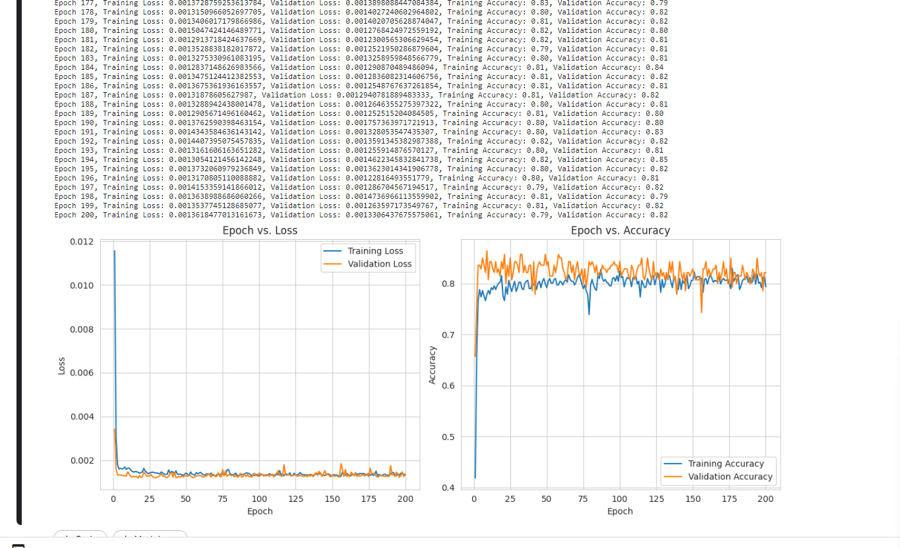
OUTPUT

Slide 33
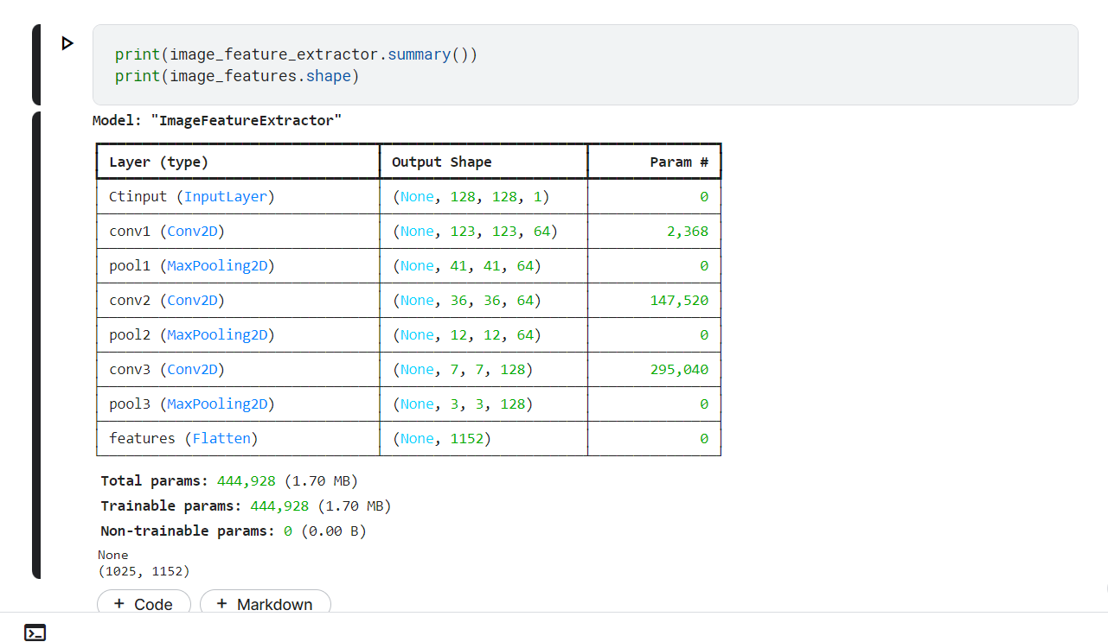
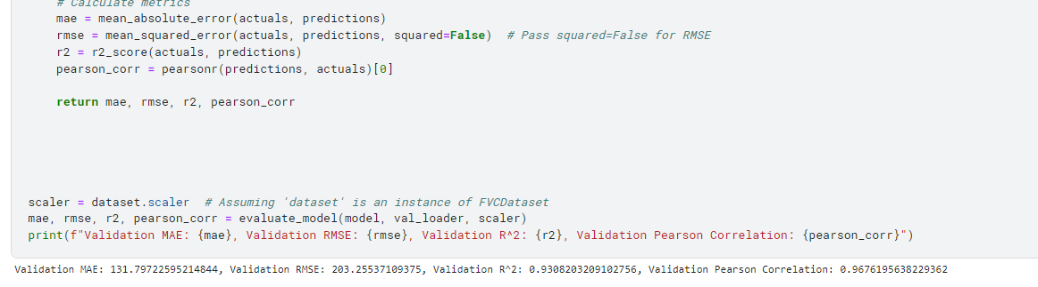
OUTPUT

Slide 34
CONCLUSION
Developed a predictive model for lung function using Forced Vital Capacity (FVC) as a key variable.
Employed advanced techniques in data preprocessing, feature engineering, and model selection to enhance model performance.
Evaluated model accuracy using Root Mean Squared Error (RMSE) and Mean Squared Error (MSE) metrics.
Conducted rigorous testing and validation procedures to ensure reliability and generalizability of results.
Demonstrated the potential of the predictive model in clinical settings for assessing and monitoring lung function in patients.
Identified opportunities for further research and validation on larger and more diverse datasets to optimize model performance.
Undertook rigorous testing and validation protocols to ensure the robustness and generalizability of the predictive model across diverse datasets.
Emphasized collaboration with healthcare professionals and integration into existing medical systems for real-world application.
Highlighted the potential of the predictive solution to improve patient care and clinical decision-making in respiratory medicine.

Slide 35
FUTURE ENHANCEMENTS
In envisioning future enhancements for the project, several avenues for refinement and expansion present themselves, each poised to further elevate the efficacy and impact of these endeavours in pulmonary fibrosis diagnosis and prognosis.
One promising direction involves the integration of multimodal data sources, such as genetic information, biomarkers, and additional clinical parameters, to enrich the predictive capabilities of these models.
By incorporating a broader array of data modalities, can 43 potentially uncover novel insights into the complex pathophysiology of pulmonary fibrosis and develop more comprehensive predictive frameworks that account for the diverse factors influencing disease progression.
Furthermore, the application of advanced deep learning techniques, such as CNN and RNNs, holds immense potential for refining the analysis of medical imaging data and enhancing the accuracy of lesion segmentation and feature extraction.
By leveraging the hierarchical representations learned by deep learning architectures, this can capture subtle patterns and spatial relationships within imaging data, thereby improving the precision of diagnostic and prognostic assessments.
Additionally, the utilization of transfer learning and domain adaptation approaches may enable the effective transfer of knowledge from related medical imaging tasks, further enhancing the generalization ability of these models across diverse patient populations and imaging protocols.

Slide 36
SOCIETAL IMPACT OF PROJECT
Social feasibility evaluates the project’s societal impact and its acceptance by stakeholders, including patients, healthcare providers, and regulatory bodies.
In the context of the AI-enabled pulmonary fibrosis progression project, several factors influence its social feasibility:
Patient Acceptance: Patients may embrace the project’s potential for improved monitoring and personalized care, positively contributing to social feasibility. However, concerns regarding data privacy and the integration of AI in healthcare may influence acceptance. Addressing these concerns through clear communication and adherence to data protection regulations is essential to enhance patient acceptance.
Healthcare Provider Acceptance: Healthcare providers may perceive AI tools as valuable assets in managing pulmonary fibrosis, potentially leading to enhanced patient care. Nevertheless, resistance to adopting new technology may arise due to training requirements or skepticism about AI’s reliability. Overcoming these barriers through comprehensive training programs and demonstrating the reliability of AI models can foster healthcare provider acceptance.
Regulatory Compliance: Compliance with healthcare regulations, such as HIPAA in the U.S. or GDPR in Europe, is imperative for the project’s social feasibility. Ensuring adherence to these regulations demonstrates commitment to data privacy and patient rights, thereby bolstering social acceptance.

Slide 37
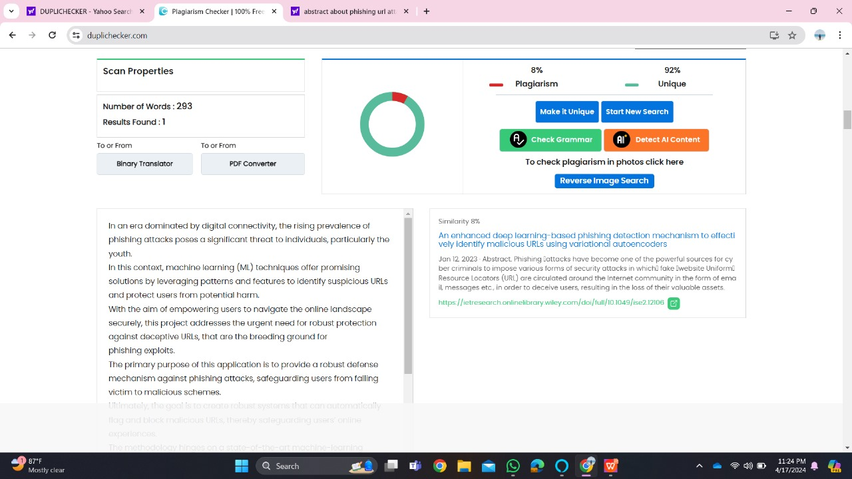
Plagiarism Report of PPT

Slide 38
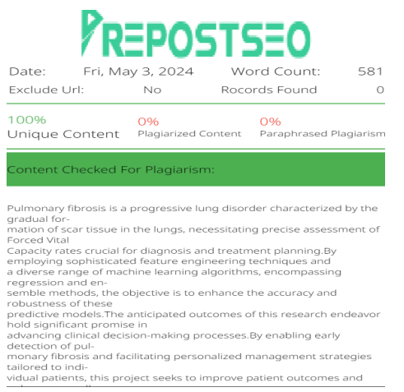
Plagiarism Report of Report

Slide 39
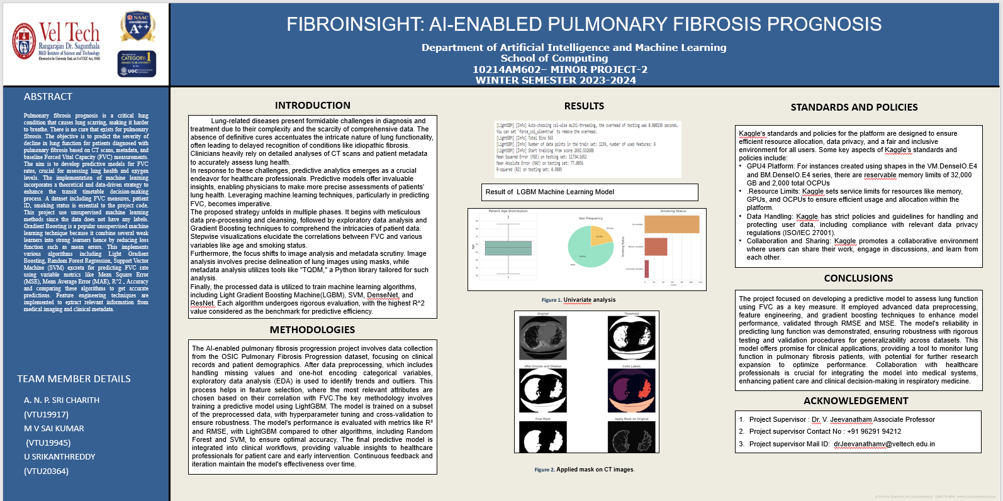
Poster Presentation

Slide 40
Web references/video links
https://www.nejm.org/doi/full/10.1056/NEJMoa1908681 [ 1]
https://link.springer.com/article/10.1186/s13075-015-0872-2 [4]
https://www.ncbi.nlm.nih.gov/pmc/articles/PMC2698015/ [ 5]
https://ieeexplore.ieee.org/abstract/document/9231239/ [ web 1]
https://ieeexplore.ieee.org/abstract/document/10047728 [ web 2]
https://ieeexplore.ieee.org/abstract/document/9528243 [web 3]
https://ieeexplore.ieee.org/abstract/document/10018624 [web 4]
https://youtu.be/BmYCAp4dRuA [video 1]
https://youtu.be/F2KxuiTXFS8 [video 2]
https://youtu.be/8aEkpRNysHE [video 3]

Slide 41
REFERENCES
[[1] Selvan, Kavitha C.,et al. ”Computer-Aided Pulmonary Fibrosis Detection Leveraging an Advanced Artificial Intelligence Triage and Notification Software.” Journal of Clinical Medicine Research 15, no. 8-9 (2023): 423.
[2] Barnes, Hayley,et al. ”Machine learning in radiology: the new frontier in interstitial lung diseases.” The Lancet Digital Health 5.1 (2023): e41-e50.
[3] Wong Alexander, Lu Jack,et al. A Tailored Deep Convolutional Neural Network Design for Prediction of Pulmonary Fibrosis Progression From Chest CT Images, Frontiers in Artificial Intelligence, volume4,2021, DOI=10.3389/frai.2021.764047,
[4] Anju Yadav, Rahul Saxena,et al. ”[Retracted] FVC-NET: An Automated Diagnosis of Pulmonary Fibrosis Progression Prediction Using Honeycombing and Deep Learning”, Computational Intelligence and Neuroscience, vol. 2022, Article ID 2832400,12pages,2022.
[5] Zhang G, Luo L,et al. Research Progress of Respiratory Disease and Idiopathic Pulmonary Fibrosis Based on Artificial Intelligence. Diagnostics. 2023; 13(3):357.

Slide 42
REFERENCES
[6] Arefeen, M. A.(2020).et al. Prediction of lung function in adolescence using epigenetic aging: a machine learning approach. Methods and Protocols, 3(4), 77.
[7] Makimoto, K., Hogg,(2023)et al. CT imaging with machine learning for predicting progression to COPD in individuals at risk. Chest, 164(5), 1139-1149.
[8] Thillai, Muhunthan,et al. ”Deep learning-based segmentation of CT scans predicts disease progression and mortality in IPF.” American Journal of Respiratory and Critical Care Medicine ja (2024).
[9] Kati Makel ¨ a MD and Mikko I. M ¨ ayr ¨ anp ¨ a¨a , ¨ Artificial intelligence identifies inflammation and confirms fibroblast foci as prognostic tissue biomarkers in idiopathic pulmonary fibrosis, Human pathology, Volume 107, January 2021.
[10] Grace Hyun J. Kim, Statistical learning technique to predict radiology progression with an application of idiopathic pulmonary fibrosis using chest CT images, 2022

Slide 43
THANK YOU

